Slide 1
Engine Performance
Basic Maintenance and Light Repair

Slide 2
Vehicle and Service Information
Manuals
Detailed information such as procedures, specification, and diagrams
VIN Number
Each vehicle has a specific number
This can be used to provide important information about that vehicle
Technical Service Bulletins
Help technicians stay up to date with recent technical changes, repair problems, etc.
Notes:
When dealing with a vehicle you need to be aware of the service information about that vehicle including the history, precautions and other information. In order to find this information out you must reference the following:
Manuals – you can view shop or service manuals, specialized manual and general repair manuals. Each of these give detailed information as to how to repair different aspects of vehicles. In order to find what you need in a manual, locate the proper manual, use the table of contents or index to find the needed information, read the instructions carefully and pay attention to the details.
VIN number – all vehicles have a unique 17 digit number that provides data about model of vehicle, the manufacture and the safety features that that particular vehicle is equipped with. This number can be used when ordering parts or dealing with recall information.
Technical Service Bulletins – help technicians stay up to date on recent technical changes, repair problems, or other service related information. These bulletins are published by manufacturers and contain up-to-date repair information related to newly discovered problems not listed in the service manuals

Slide 3
Fuel Filters

Slide 4
Fuel Filters
Remove contaminants such as water, rust and other debris
Keep debris from entering the fuel pump, fuel lines, pressure regulator, fuel rail and injector
Notes:
Fuel filters are used to remove contaminants such as water, rust and other debris.
They are also used to keep debris from entering the fuel pump, fuel lines, pressure regulator, fuel rail and injector.

Slide 5
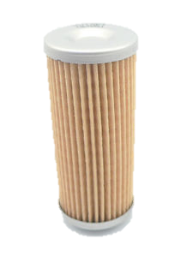
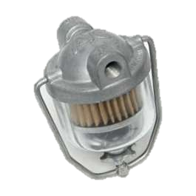
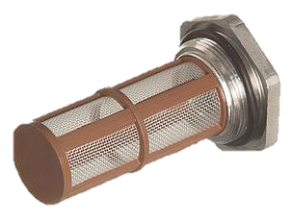
Types of Fuel Filters
Pleated
Bowl
Canister
Fuel Strainer
Notes:
Types of fuel filters
Pleated fuel filter
Made of coated paper or plastic
Most common fuel filter element found in gasoline fuel systems
Bowl fuel filter
Found on modern diesel engines
These can easily capture water since water is heavier than fuel and the water settles to the bottom of the bowl while the light fraction gasoline floats on top of the water
Canister fuel filter
Housed inside a metal container mounted in the fuel line
Fuel strainer
Often called a soft metal sock
On the inlet of the in-tank fuel pump keeps debris from entering the system

Slide 6
Fuel Filter Locations
Located almost anywhere in the fuel circuit
In the fuel tank on the end of the fuel pickup tube
In the fuel line before the fuel rail, fuel injectors, diesel injection pump, or carburetor
Inside the fuel pump
In the fuel line right after the electric fuel pumps
Under the fuel line fitting in antique carburetors
Notes:
Fuel Filters can be located almost anywhere within the fuel circuit.
The most common locations are:
In the fuel tank on the end of the fuel pickup tube
In the fuel line before the fuel rail, fuel injectors, diesel injection pump, or carburetor
Inside the fuel pump
In the fuel line right after the electric fuel pumps
Under the fuel line fitting in antique carburetors
When in doubt about the location, refer to the service manual

Slide 7
Fuel Filter Service
Service involves periodic replacement or cleaning of system filters
Some filter may be clogged
Fully clogged
Partially clogged
If a filter is clogged and contaminants are found in the fuel system, the tank, pump and lines should be flushed with clean fuel
Notes:
Fuel Filter Service
Involves periodic replacement or cleaning of system filters
It may also include located clogged fuel filters that are upsetting fuel system operations
Fully clogged – restricts the flow of fuel to the pressure regulator, gasoline injectors, diesel injection pump, or carburetor
Partially clogged – may cause the engine to temporarily loose power or stall when a specific engine speed is reached
On modern vehicles, a clogged in-tank strainer is hard to diagnose but is very common
When clogged, the filter can collapse and stop all fuel flow
If a filter is clogged and contaminants are found in the fuel system, the tank, pump and lines should be flushed with clean fuel.

Slide 8
Intake System
Air Filters, Filter Housings, and Intake Ductwork

Slide 9
Air Filter
Removes foreign material from the air entering the engine
Most filters use paper filter elements
Service
Cleaning
Can be cleaned by tapping or blowing the dirt off
Replacing
If the filter is extremely dirty, it needs to be replaced
Notes:
An air filter or air cleaner removes foreign matter from the air entering the engine intake manifold
Most filters use paper filter elements
Air filter service usually includes replacing or cleaning the filter element
If it is only slightly dirty the dirt may be tapped or blown off from the filter
A paper filter element is usually replaced with a new filter. When replacing a filter element, you should also clean out the filter housing

Slide 10
Air Filter Housing
A metal or plastic housing that holds the air filter
This housing protects the air filter from outside debris not coming through the engine intake
Inspect the housing for dirt, grease, oil
Notes:
A metal or plastic housing that holds the air filter
This housing protects the air filter from outside debris not coming through the engine intake
Inspect the housing for dirt, grease, oil
If oil is found in the housing, a thorough inspection of the PCV system needs to be done. If the PCV is not functioningoil can back up into the air cleaner housing.

Slide 11
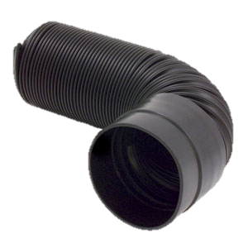
Intake Ductwork
Disperses air from the air filter housing to the engine
Service
Ensure that all hoses have no holes
No corrosion
Notes:
Disperses air from the air filter housing to the engine
Service
Ensure that all hoses have no holes
No corrosion

Slide 12
Exhaust System
Exhaust Manifold, Exhaust Pipes, Muffler, Catalytic Converter, Resonator, Heat Shield

Slide 13
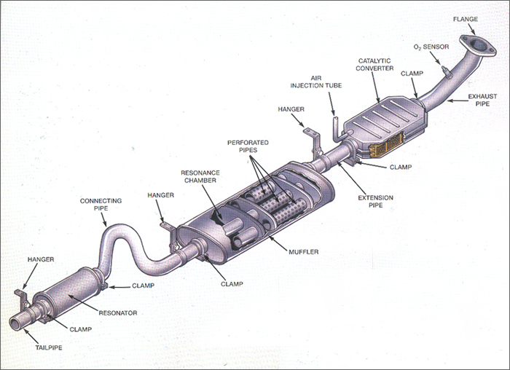

Slide 14
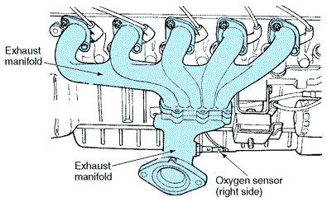
Exhaust Manifold
Fastens over the exhaust ports to carry burned gases into the exhaust system
Connects the cylinder head exhaust ports to a header pipe
Can be made of heavy cast iron or lightweight aluminum or stainless steel tubing
Notes:
The exhaust manifold fastens over the exhaust port to carry burned gases into the exhaust system.
It is connected to the cylinder head exhaust port specifically and then is connected to the header pipe.
These manifolds can be made of heavy cast iron or lightweight aluminum or stainless steel tubing.

Slide 15
Exhaust Manifold Service
Always check for cracks burns, erosion and rust
Check for warpage with a straightedge and flat feeler gauge:
Lay the straightedge over the port openings
Try to slide feeler gauge blades of different thicknesses under the straightedge. Measure at different points on the manifold
The thickest blade that easily slides under the straightedge indicates the intake manifold warpage
If warpage is more than specifications, the intake manifold sealing surfaces must be machined or a new manifold installed.
Notes:
Always inspect an exhaust manifold before installation
Look for cracks, burned areas, eroded mating surfaces and severe rust damage.
Check for exhaust manifold warpage with a straightedge and flat feeler gauge
Lay the straightedge over the port openings
Try to slide feeler gauge blades of different thicknesses under the straightedge. Measure at different points on the manifold
The thickest blade that easily slides under the straightedge indicates the intake manifold warpage
If warpage is more than specifications, the intake manifold sealing surfaces must be machined or a new manifold installed.
A leaking exhaust manifold will be indicated by a clicking sound as the exhaust gases blow out between the cylinder head and manifold

Slide 16
Exhaust Pipes
Three types of exhaust pipes
Header Pipe
Intermediate Pipe
Tail Pipe
Usually made of rust-resistant tubing
Make sure the pipes are cleared of any obstructions and clogs
Notes:
Header pipe, intermediate pipe and tail pipe
Header pipe is made of steel tubing that carries exhaust gases from the exhaust manifold to the catalytic converter
Intermediate pipe is a piece of steel tubing that carries exhaust gases from the catalytic converter to the muffler
Tail pipe
Consists of tubing that carries exhaust gases from the muffler to the rear of a car body
One of two tailpipes should be visible at the rear of the vehicle
They should extend out as far as the rear body overhand or bumper
Usually made of rust-resistant steel tubing
One end of each pipe may be enlarged to fit over the end of the next pipe
To keep the pipes clean make sure that there are no debris build up or obstructions. This could cause a car to back fire an run rough.

Slide 17
Muffler
Sheet metal chamber that dampens pressure pulsations to reduce exhaust noise
This is used in conjunction with a resonator
Service
To ensure proper function, listen for a rattling noise when the car accelerates.
This checks for blockages or loose parts
Check for rust
Notes:
Muffler
A sheet metal chamber that dampens pressure pulsations to reduce exhaust noise
It is used in conjunction with a resonator to quiet the noise
Service
To ensure proper function, listen for a rattling noise when the car accelerates.
This checks for blockages or loose parts
Check for rust
Do so by pushing upward on the muffler to check for weak, rusted inlet and outlet pipes.

Slide 18
Catalytic Converter
An enclosed, high-temperature afterburner that consumes and chemically treats pollutants in the engine exhaust
One or more catalytic converter can be used in one exhaust system
Types of Catalytic Converter
Mini catalytic converter
Two-way catalytic converter
Three-way catalytic converter
Dual-bed catalytic converter
Notes:
Catalytic convertor
An enclosed, high-temperature afterburner that consumes and chemically treats pollutants in the engine exhaust
An afterburner used to reduce the amount of exhaust pollutants entering the atmosphere
One or more catalytic converters can be located in the exhaust system.
Types of convertors
Mini catalytic converter
A very small converter placed close to the engine exhaust manifold
It heats up quickly to reduce emissions during engine warm-up
Used in conjunction with a larger, main converter
Two-way catalytic converter
Sometimes called an oxidation converter
Can only reduce two types of emissions (HC and CO)
Three-way catalytic converter
Also called a reduction-type converter
Capable of reducing all three types of emissions (HC, CO and NO)
Dual-bed catalytic converter
Contains two separate catalyst units enclosed in a single hosueing
Normally has both the three way and two way catalyst
A mixing chamber is provided between the two
Air is forced into the mixing chamber to help burn the HC and CO emissions

Slide 19
Catalytic Converter Temp Test
A properly running catalytic converter will have an approximate 100°F difference in temperature, front to rear
Catalytic converter temperature check quickly tests for an inoperative converter catalyst
Attach a shop vent hose to the tailpipe(s)
Warm the engine and catalytic converter to full operating temperature
Place and secure the vehicle on a lift
Touch a temperature probe on the front or inlet end of the suspect catalytic converter. Record the temperature.
Touch your temperature probe on the rear of the converter near the outlet pipe. Record the temperature.
Subtract the rear temperature reading from the front temperature reading.
Notes:
A properly running catalytic converter will have an approximate 100°F difference in temperature, front to rear
Catalytic converter temperature check quickly tests for an inoperative converter catalyst
Attach a shop vent hose to the tailpipe(s)
Warm the engine and catalytic converter to full operating temperature
Place and secure the vehicle on a lift
Touch a temperature probe on the front or inlet end of the suspect catalytic converter. Record the temperature.
Touch your temperature probe on the rear of the converter near the outlet pipe. Record the temperature.
Subtract the rear temperature reading from the front temperature reading.

Slide 20
Resonator
A hollow chamber in the exhaust tract that creates a frequency of pulses that reverse the pulses coming down the exhaust pipe
It works in conjunction with the muffler to quiet the exhaustion being emitted from the car
You care for a resonator just like you do a muffler
Check for rattling to indicate loose pieces or debris build-up
Notes:
A resonator is a hollow chamber in the exhaust tract that creates a frequency of pulses that reverse the pulses coming down the exhaust pipe
It works in conjunction with the muffler to quiet the exhaustion being emitted from the car
You care for a resonator just like you do a muffler
Check for rattling to indicate loose pieces or debris build-up

Slide 21
Heat Shields
Metal plates that prevent exhaust heat from transferring to the fuel lines, floor, transmission and engine
Located in areas where the exhaust system components are close to the vehicle’s body or near the ground
The shields reduce the amount of heat transferred into the body and protect items under the vehicle
Heat shields should be flat and not bent
Notes:
Metal plates that prevent exhaust heat from transferring to the fuel lines, floor, transmission and engine
Located in areas where the exhaust system components are close to the vehicle’s body or near the ground
The shields reduce the amount of heat transferred into the body and protect items under the vehicle
Heat shields should be flat and not bent

